Slide 1

TRAINING AND DEVELOPMENT
STATISTICS
&
MACHINE LEARNING INTRO

Slide 2
Content
INTRO TO STATISTICS
What is Statistics?
Big Picture of Statistics
The Process of Statistics
INTRO TO ML
Difference between conventional programming and Machine Learning
Inference vs Prediction
Machine Learning Project Life Cycle
HANDS ON DEMOS

Slide 3
Intro to Statistics

Slide 4
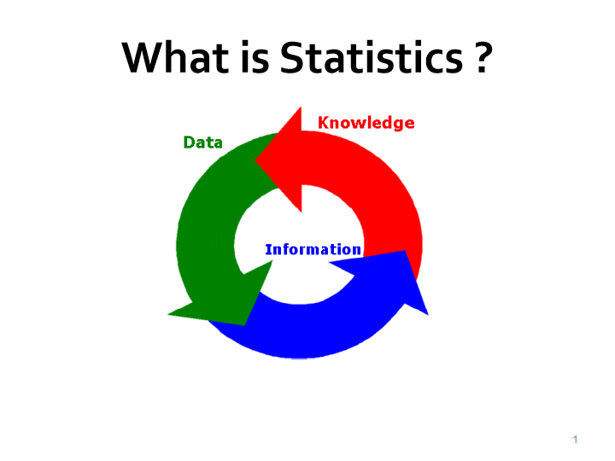

Slide 5
What is Statistics ?
Statistics is the science of :
Collecting
Organizing
Summarizing
Analyzing , and
Drawing conclusions ..from Data
Notes:
1. Analyzing would include things like Exploratory Data Analayis (EDA) to get insights
2. Drawing conclusions would include making decisions, estimations or predictions --Inference

Slide 6
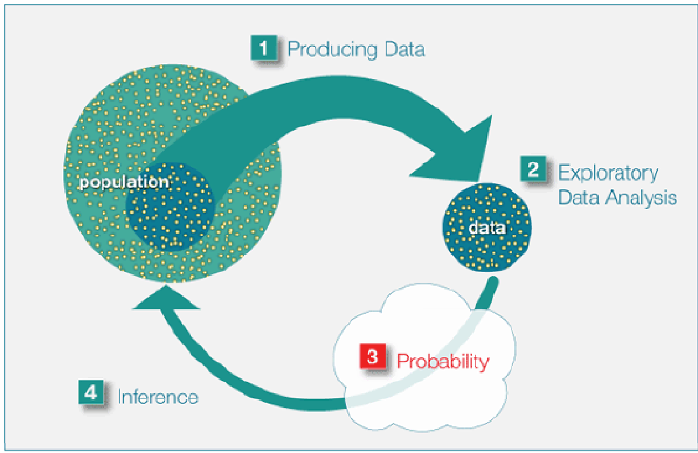
THE BIG PICTURE OF STATISTICS

Slide 7
STEP 1- PRODUCING DATA

Slide 8
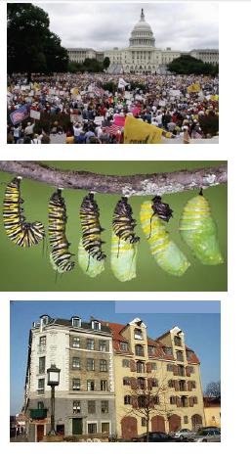
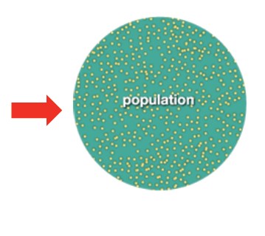
Population
A population is a complete collection of all
subjects that are studied

Slide 9
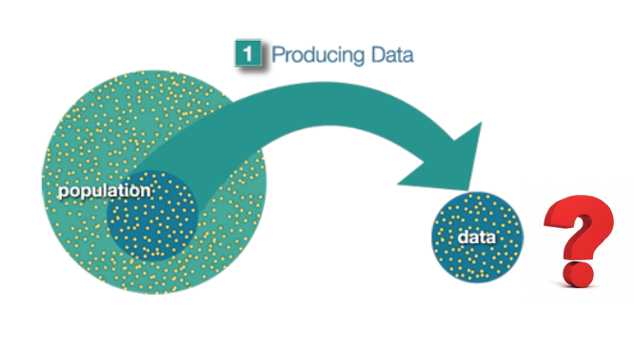
Samples
A sample is a subset of the population

Slide 10
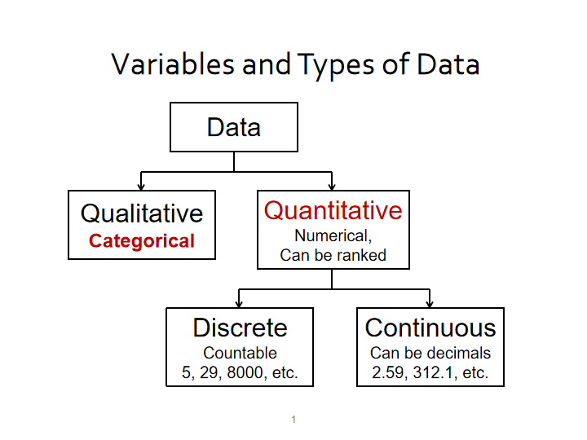

Slide 11
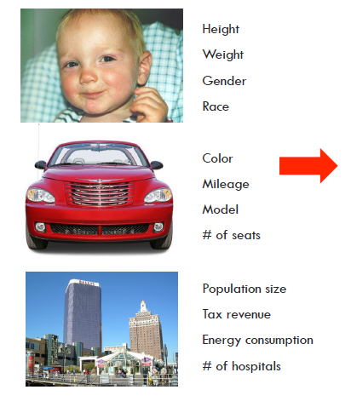

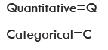
Variables & Data
Q
Q
C
C
C
Q
C
Q
Q
Q
Q
Q

Slide 12
Pop Quiz 1: Variables & Data
The height of president Lincoln is a variable ( True or False)?
Data were collected about students in a college. Three variables were recorded for each student: number of facebook followers, height, and whether the student had previously taken a datascience course. Classify each of the variables as Quantitative or Categorical. If Quantitative is it Discrete or Continuous ?
False, height is a variable but height of president Lincoln is a
data point (datum).
Quantitative(discrete)
Quantitative(continuous)
Categorical(yes/no)

Slide 13
Descriptive vs Inferential Statistics
National Census
The Branch of statistics thats deals with collection, organization, summarization, and presentation of data is called Descriptive statistics
Generalizing from samples to populations, performing estimations and hypothesis tests, determining relationships among variables, and making predictions.
Are fresh graduate data scientist salaries different from working professional ones ?
Estimating average data scientist salary in Chennai ?
Is there relationship between gender and data scientist salary ?
predict the data scientist compensation

Slide 14

Sampling
Descriptive
Representative Sample
Inferential

Slide 15
Data Collection and Sampling Techniques
Data is collected from samples.
Sample should be to be unbiased (random &representative)
We should use probability sampling to obtain random and representive samples

Slide 16
Some Probability Sampling Techniques
Simple Random Sample(SRS)
Random – random number generator
Systematic – every k^{th} subject, k= N/n
Stratified – divide population into “layers”
Cluster – use intact(geographical) groups
Convenient (Non-probability)– mall surveys
Note: Whenever we use the word “sample” we mean a “ random & representative sample”.
Notes:
N= 2000, n=50, k= 2000/50 = 40 ,sample ids: 12, 52, 92, ….

Slide 17
Quick Recap
Two major branches of Statistics are ________________and _______________
The group of all subjects under study is called __________________
A group of subjects selected from the group of all subjects under study is called _____________
The number of students in a classroom is an example of ________________data .
For a sample to be unbiased we should use_________methods of sampling.
Descriptive
Inferential
Population
Sample
Quantitative
Probability

Slide 18
THE BIG PICTURE OF STATISTICS

Slide 19
STEP 2- Exploratory Data Analysis, aka EDA

Slide 20
What is EDA ?
The purpose of exploratory data analysis(EDA) is to examine data to find out what information can be uncovered about the data such as the center and the spread and to discover patterns and relationships between the data.
Exploratory data analysis was developed by John Tukey and presented in his book Exploratory Data Analysis (Addison-Wesley, 1977).
EDA relies heavily on visualization as it is a most powerful way to represent data

Slide 21
What is done in EDA ?
EDA uses a lot of concepts like:
--Cleaning Data
--Organizing the Data
--Univariate Analysis
- Summarizing the Data to examine center & spread
- Vizualizing the data to examine the distribution shape
--Bivariate Analysis
- Studying corretionships between variables in the data
- Chi Square
- ANOVA

Slide 22
a) Cleaning Data
Look for incorrect data points due to data engineering errors
Look for inconsistensies in the data
Look for missing values and make a plan for imputation

Slide 23
b) Organizing Data
UsingTables and Charts to Organize our data:
Easy to eyeball the data
Understand the center and shape if distribution
Check for outliers

Slide 24
Examples of Raw Data
CATEGORICAL DATA
Twenty-five army students were given a blood test to determine their blood type.
Raw Data:
A,B,B,AB,O , B,B,O,A,O , A,O,O,O,AB , AB,A,O,B,A, O,O,B,AB,B

Slide 25
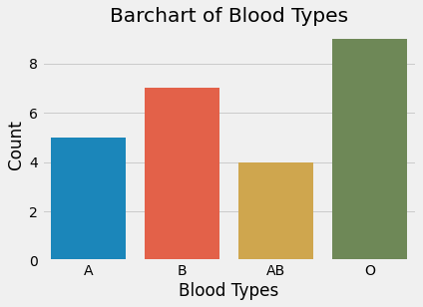
Visualizing Categorical Data
Use Frequency tables & Bar charts
Shows frequency(count) or proportion(%) of observations in each category
Observation:
1. O is the most common bllod type
2. AB is the most rare blood type

Slide 26
Example of RawData
NUMERICAL DATA
The following data gives maximum temperatures of the 50 states.
112 113 120 119 111 104 100 127 120 134 118 105 110 109 112 110 118 117 116 118 118 122 106 110 116 108 122 114 114 105 109 107 112 114 115 118 117 110 121 111 120 113 120 117 105 110 118 112 114 114

Slide 27
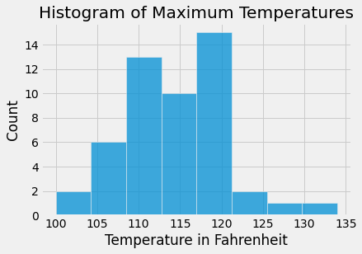
Visualizing Numerical Data
Use frequency tables and Histograms
Shows the frequency or relative frequency of each class interval
Observation:
1. Average Max temperatue is around 115 F
2. Most of the cities have temperatures between 105 and 120

Slide 28
c) Summarizing Data
We summarize data by finding basically there focal points of information:
1. Center
2. Spread
3. Position

Slide 29
c) Summarizing Data–Measures of Center
Average means the center of the distribution or the most typical case
Measures of average are also called measures of central tendency
Most common measures of central tendency are:
Mean
Median
Mode
Do you want to get average income?

Slide 30
Calculating Mean ,Median and Mode
Find the mean, median and mode of the signing bonuses of eight IPL players for a specific year. The bonuses in millions of rupees are
18.0, 14.0, 34.5, 10, 11.3, 10, 12.4, 10
Mean = sum of observations /number of observations =
= (18.0 + 14.0 + 34.5 + 10 + 11.3 +10 +12.4 +10) / 8
= 120.2 /8 = 15.025 = 15.03 million rupees (rounded to one decimal place more than raw data)
Median is the centermost observation after sorting the data
Sorted Data : 10, 10, 10, 11.3, 12.4, 14.0, 18.0, 34.5
Median = mean of 4th and 5th observation
= (11.3 + 12.4)/2
= 11.85 million rupees
Mode is the most frequently occuring observation
The mode is 10 million rupees

Slide 31
Which diet is better?
Latest Weight loss diet
DIET -1
Mean Weight loss = 34.5 Kg
Latest Weight loss diet
DIET -2
Mean Weight loss = 18.5 Kg

Slide 32
Which diet is better : Analyze and Decide
The change in weight (lbs) of two dieting groups is shown :
Diet 1: +4, +3, 0,-3, -4, -5, -11, -14, -15, -300
Diet2: -8, -10, -12, -16, -18,-20,-21,-24,-26, -30
Calculate the average weight loss in each group and decide which is better.
Answer: Diet 1: mean=-34.5, median =-4.5
Diet 2: mean = - 18.5, median =-19
Diet 2 is better since there are no outliers and mean and
median agree with each other

Slide 33
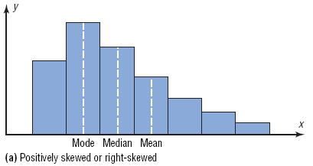
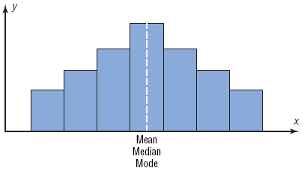
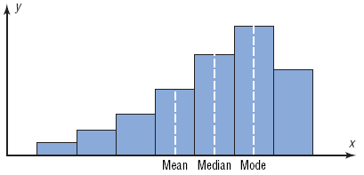
Distributions
Note how the mean gets dragged towards the skew
Positively Skewed or Right Skewed
Negatively skewed or eft Skewed
Symmetric

Slide 34
Measures of Spread(Dispersion)
Checking the variability of the data --how spread it is
Measures of spread include
- Range
Variance
Standard Deviation
Should I Order only Shirt Size 40 for my Shop as the
average customer size is 40?

Slide 35
Measures of Spread: Range
The difference between the highest and lowest values in a data set is called Range
R = Highest Value - Lowest Value
Very useful to get the spread quickly

Slide 36
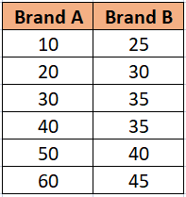
Which Brand of Paint is more Consistent ?

Slide 37
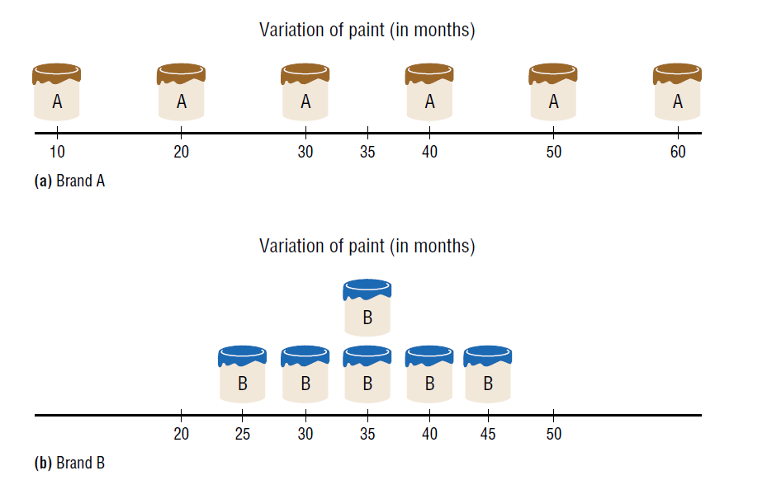
Examine Data Sets Graphically
Which Brand is more Variable ?
Which Brand is more Consistent ?
Range = 60 -10=50
Brand B has lower range and is less variable and hence more consistent
Range = 45 -25=25
Range is affected by outliers

Slide 38
Average Distance From the Mean
Hint: Distance from the mean =

Slide 39
Variance & Standard Deviation
The variance is the average of the squares of the distance each value is from the mean. (Mean Squared Distance)
The standard deviation is the square root of the variance.
The standard deviation is a measure of the average spread of the data ( not the exact average distance ).

Slide 40
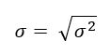
Population and Sample Variance
The population variance
The sample variance

Slide 41
Pop Quiz
If variance of a dataset is 9 then the standard deviation is :
a) 9
b) 3
c)-3
d) 3 & -3

Slide 42
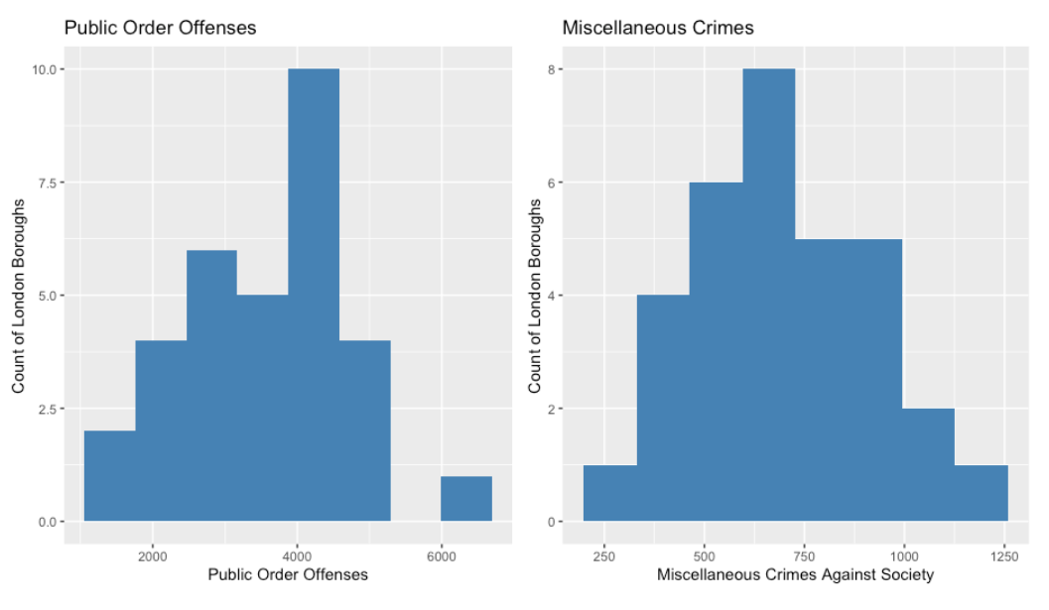
Which histogram has larger standard deviation

Slide 43
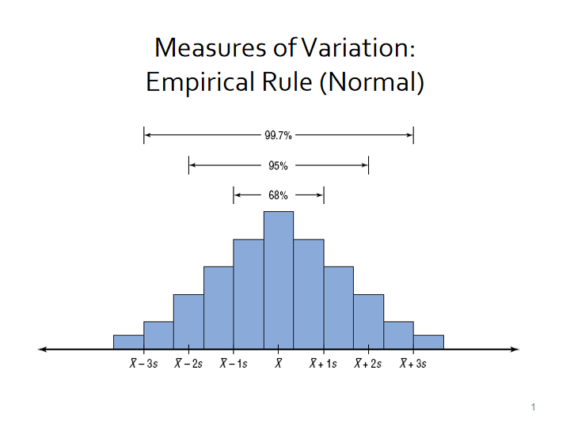
Normal healthy adults have a mean systolic BP of 120 mm of Hg with standard deviation of 10 . What percentage would you expect to have BP :
a) between 100 and 140
b) above 140 mm Hg ?

Slide 44
Measures of Position
Measures of Position
Percentiles
Quartiles
She got 80 % marks then how come she is in the 90th percentile ?

Slide 45
Measures of Position: Percentiles
The values that divide the data set into 100 equal parts are called Percentiles
There are 99 percentiles
The values that divide the data set into 4 equal parts are called quartiles
There are 3 quartiles

Slide 46
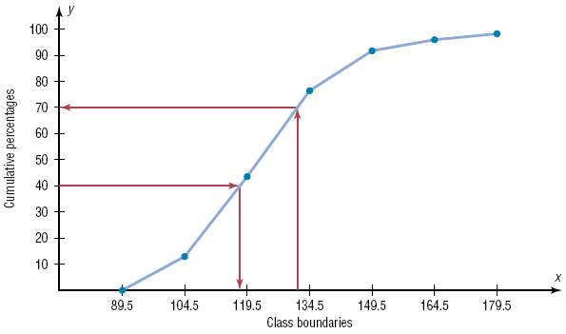
Measures of Position: Example of a Percentile Graph
P
E
R
C
E
N
T
I
L
E
What is the percentile rank for a
Blood pressure of 130 ?
70th percentile
What is the 40th percentile BP?
118 mm Hg
What is the 60th percentile BP ?
(Blood Pressure)

Slide 47
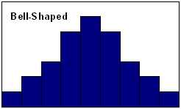
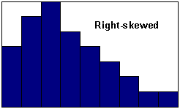
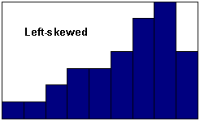
Other EDA uses- Shapes of Distributions
This is Normal

Slide 48
Other EDA USES- Catch Outliers
The group of numbers : Low, Q₁, MD, Q₃, High is the five-number summary
We can us the Boxplot to represent a five number summary
Boxplots are very useful to catch outliers in the data ( extremely high or low values)

Slide 49
Example Boxplot
Find the 5 number summary and construct a boxplot for the data. 89, 47, 164, 296, 30, 215, 138, 78, 48, 39
Sort the data
30, 39, 47, 48, 78, 89, 138, 164, 215, 296
Five-Number Summary: 30-47-83.5-164-296
Low
Q₁
MD
Q₃
High
47
83.5
164
30
296

Slide 50
Informations from Boxplots
To find average use the median
To find the range use High –Low
To find variability use the IQR (length of the boxes)
If median is near the centre of the box and lines are about equal ⇒ symmetric
If median is at the left side of the box and/or right line is larger ⇒ right skew
If median is at the right side of the box and/or left line is larger ⇒ left skew

Slide 51
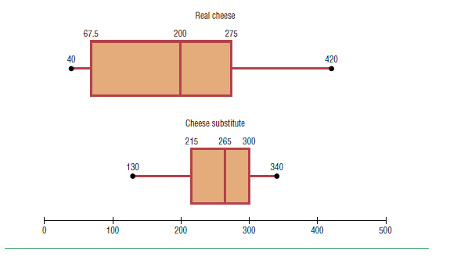
Compare trhe two boxplots and give your interpretation
Median = 200
Range = 420-40 = 380
IQR = 275-67.5 = 207.5
Shape ; left skew
Median = 265
Range = 340-130 = 210
IQR = 300-215= 85
Shape : negative skew
Cheese substitute has higher median ,but Real cheese shows greater variability

Slide 52
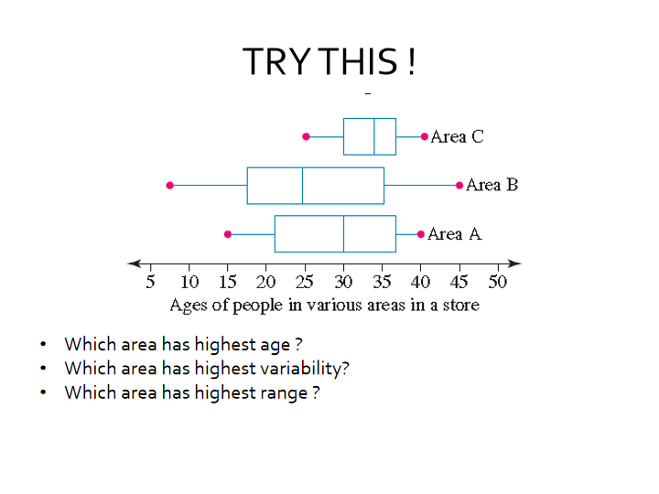

Slide 53
EDA uses- Correlation Coefficient
Correlation checks whether a linear relationship between variables exists. It includes the following:
1) Checking a scatter plot between two variables’
2) Calculating the Correlation Coefficient
ICE CREAM SALES ARE CAUSING DROWNING DEATHS !!!

Slide 54
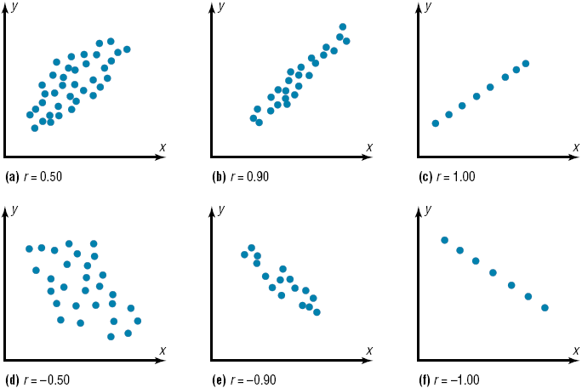
Correlation using Scatter Graphs
Moderate +ve Correlation
Strong +ve correlation
Perfect +ve correlation
Moderate –ve correlation
Strong –ve correlation
Perfect –ve correlation

Slide 55
Weak , Moderate, Strong Correlations
Correlation Coefficient ranges from -1 to +1
A general guide in medical field:
>.70 is strong correlation
Between 0.3 to 0.7 is moderate correlation
Between 0.1 to 0.3 is weak correlation

Slide 56
Correlation is Not Causation
When the Correlation Coefficient is high It doent means that x is causing y . Rather it could be any of the following:
1. Reverse
2. Confounding
3. Coincidental

Slide 57
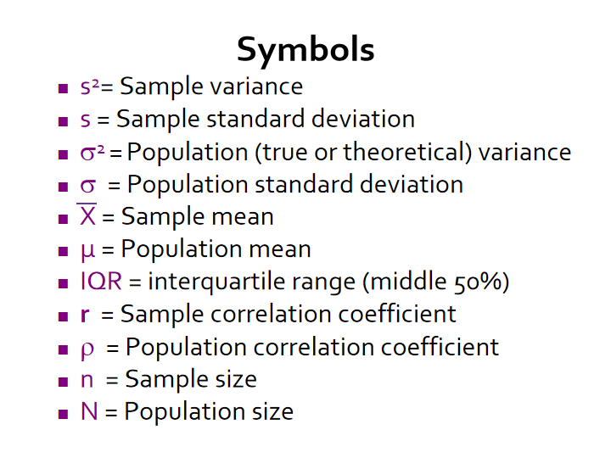

Slide 58
STEP 3- Probability

Slide 59
THE BIG PICTURE OF STATISTICS

Slide 60
Teaser
A classic statistics problem: The Monty Hall Problem
The presenter shows you 3 doors (A, B, C), one of which has a expensive prize behind it (the other two have nothing).
You choose door A; Monty Hall opens door B and shows you that there is nothing behind it. Then he gives you the choice of sticking with A or switching to C.
Should you stay or switch; or does it make no difference

Slide 61
Probability
Probability can be defined as the chance of an event occurring.
Some examples of how probability is used everyday would be weather forecasting, “75% chance of snow”

Slide 62
Sample Space
A sample space is the set of all possible outcomes of a probability experiment.

Slide 63
Sample Spaces
Experiment
Sample Space
Toss a coin
Head(H),
Tail(T)
Roll a die
1, 2, 3, 4, 5, 6
Answer a true/false
True, False
question
Toss two coins
HH,
HT, TH, TT

Slide 64
Note: The word “and” means “at the same time”

Slide 65
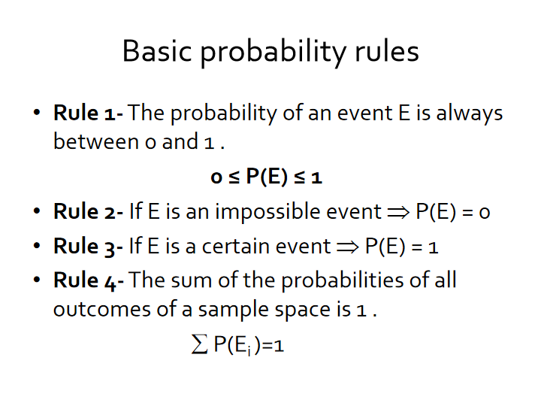

Slide 66
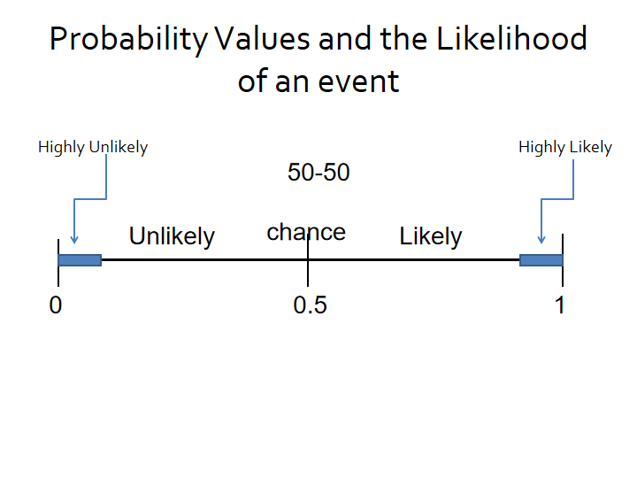

Slide 67


Which of the following events is most likely to occur ?
Scoring 90% or more in an exam, when only 5% of students score this highly.
A restaurant receiving an order for a steak, where steak orders have made up 100 out of 1000 total orders to date
Picking a red card out of a standard pack of 52 playing cards, where half of the cards are red and the other half are black.
Drawing a person's name out of a hat that also contains 19 other names.

Slide 68
Some Important Topics in Probability
Classical vs Empirical Probability
Mutually exclusive events
Independent Events
Addition Rule
Multilication Rule
Conditional Probability
Baye’s Theorem

Slide 69
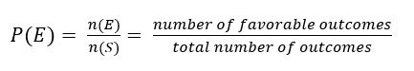
Sample Spaces and Probability
Classical probability relies on sample spaces to find the numerical probability that an event will happen. It assumes that all outcomes in the sample space are equally likely to occur.
Note: Equally likely events have the same probability of occurring

Slide 70
Example : Gender of Children
If a family has three children, find the probability that two of the three children are girls.
Sample Space:
BBB BBG BGB BGG GBB GBG GGB GGG
Three outcomes (BGG, GBG, GGB) have two girls.
The probability of having two of three children being girls is 3/8.

Slide 71
Example : Finding Complements(Not E)
Find the complement of each event.
Event
Complement
of the Event
Rolling a die and getting a 4
Getting a 1, 2, 3, 5, or 6
Selecting a letter of the alphabet
Getting a consonant (assume y is a
and getting a vowel
consonant)
Selecting a month and getting a
Getting February, March, April, May,
month that begins with a J
August, September, October,
November, or December
Selecting a day of the week and
Getting Saturday or Friday
getting a weekday
Rolling 2 coins and getting 2 heads
Rolling 2 coins and getting at least 1 tail

Slide 72
Example : Residence of People
If the probability that a person lives in an industrialized country of the world is , find the probability that a person does not live in an industrialized country.

Slide 73
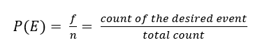
Probability
Empirical probability (or Relative frequency probability) depends on data to find the likelihood of the event happening.
Note: Empirical probability is based on observation (data)

Slide 74
Example : Blood Types
In a sample of 50 people, 21 had type O blood, 22 had type A blood, 5 had type B blood, and 2 had type AB blood. Set up a frequency distribution and find the following probabilities.
a. A person has type O blood.
Type | Frequency
A | 22
B | 5
AB | 2
O | 21
Total 50

Slide 75
Example : Blood Types
In a sample of 50 people, 21 had type O blood, 22 had type A blood, 5 had type B blood, and 2 had type AB blood. Set up a frequency distribution and find the following probabilities.
b. A person has type A or type B blood.
Type | Frequency
A | 22
B | 5
AB | 2
O | 21
Total 50

Slide 76
Probability of Two or More Events
In a large hospital, what is the probability that a randomly selected individual is a:
A) Nurse or a doctor
- The person is a nurse
- The person is a doctor
B) Male or a nurse
- The person is a male
- The person is a nurse
- The person is both a male and a nurse
Mutually Exclusive (M.E)
Not M.E

Slide 77
Mutually Exclusive Events
Two events are mutually exclusive events if they cannot happen together , for example getting a head and getting a tail are mutually exclusive

Slide 78
Addition Rules for Probability
Two events are mutually exclusive events if they cannot occur at the same time (i.e., they have no outcomes in common)
Note: In probability ‘or’ means to add

Slide 79
Example: Political Affiliation
At a political rally, there are 20 Republicans, 13 Democrats, and 6 Independents. If a person is selected at random, find the probability that he or she is either a Democrat or an Independent.
Mutually Exclusive Events

Slide 80
Example : Medical Staff
In a hospital unit there are 8 nurses and 5 physicians; 7 nurses and 3 physicians are females.
If a staff person is selected, find the probability that the subject is a nurse or a male.
Staff
Females
Males
Total
Nurses
7
1
8
Physicians
3
2
5
Total
10
3
13

Slide 81
Multiplication Rules
Two events A and B are independent events if occurence of A does not affect the probability of the occurence of B
Marginal probability
Joint probability
Conditional probability
Note: In probability ‘and’ means to multiply

Slide 82
Example : Tossing a Coin
A coin is flipped and a die is rolled. Find the probability of getting a head on the coin and a 4 on the die.
This problem could be solved using sample space.
H1, H2, H3, H4, H5, H6, T1, T2, T3, T4, T5, T6

Slide 83
Example: Survey on Stress
Approximately 9% of men have a type of color blindness that prevents them from distinguishing between red and green. If 3 men are selected at random, find the probability that all of them will have this type of red-green color blindness.

Slide 84
Testing For Independence
A & B are independent ⇔ P(A&B) = P(A)*P(B)

Slide 85
Is Blood Type independednt of RH factor ?
Consider the following distribution of Blood Types in 100 donors:
P(O+) = P(Rh+)xP(O) = .84x.45 = 0.38
Blood type/RH-status | RH ⁺ | RH⁻
O | 38 | 7
A | 34 | 6
B | 9 | 2
AB | 3 | 1
Total | 84 | 16

Slide 86

Which are dependent and independent events ?
The probability of being offered a job having made it to the final interview stage
The probability of rolling a 6 within two attempts using a fair dice
The probability of more than 100 mm of rain given that it is July
The probability of winning a lottery
The probability of flipping a coin and getting heads given today is Friday
The probability of RCB winning IPL again given they have Kohli
Dependent
Independent
Dependent
Independent
Dependent?

Slide 87
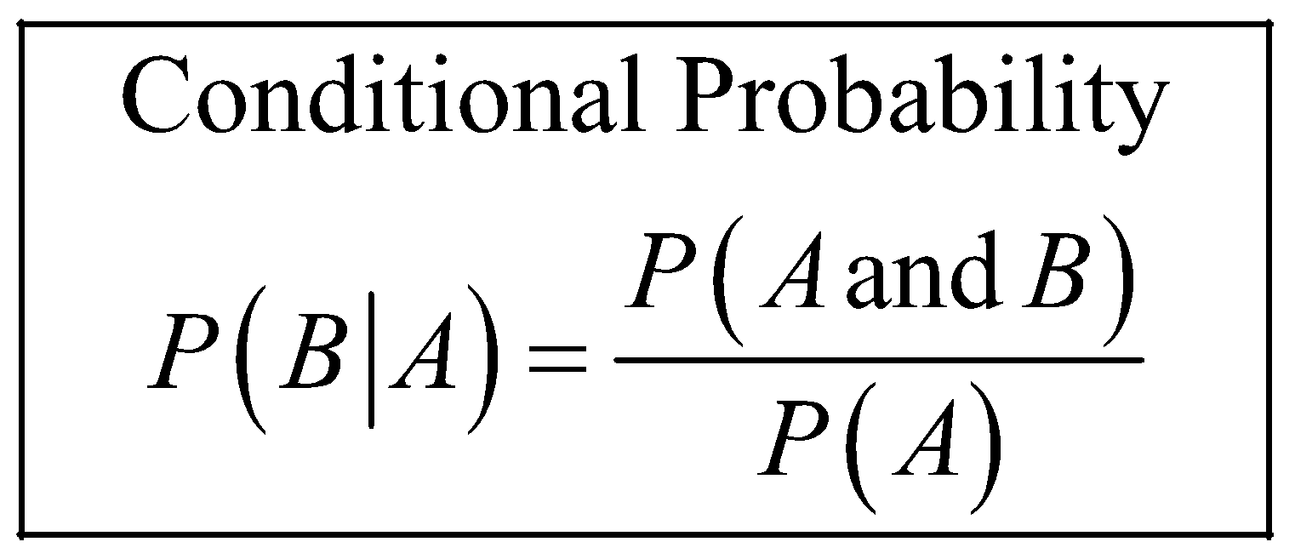
Conditional Probability
Conditional probability is the probability that the second event B occurs given that the first event A has occurred.
Note: This may be visualized as restricting the sample space to A

Slide 88
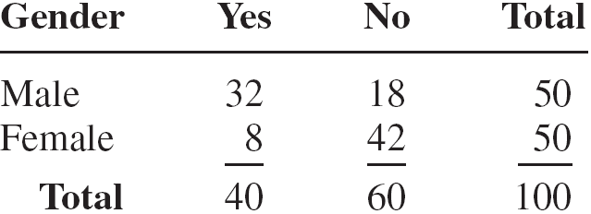
Women in the Military
A recent survey asked 100 people if they thought women in the armed forces should be permitted to participate in combat. The results of the survey are shown.

Slide 89
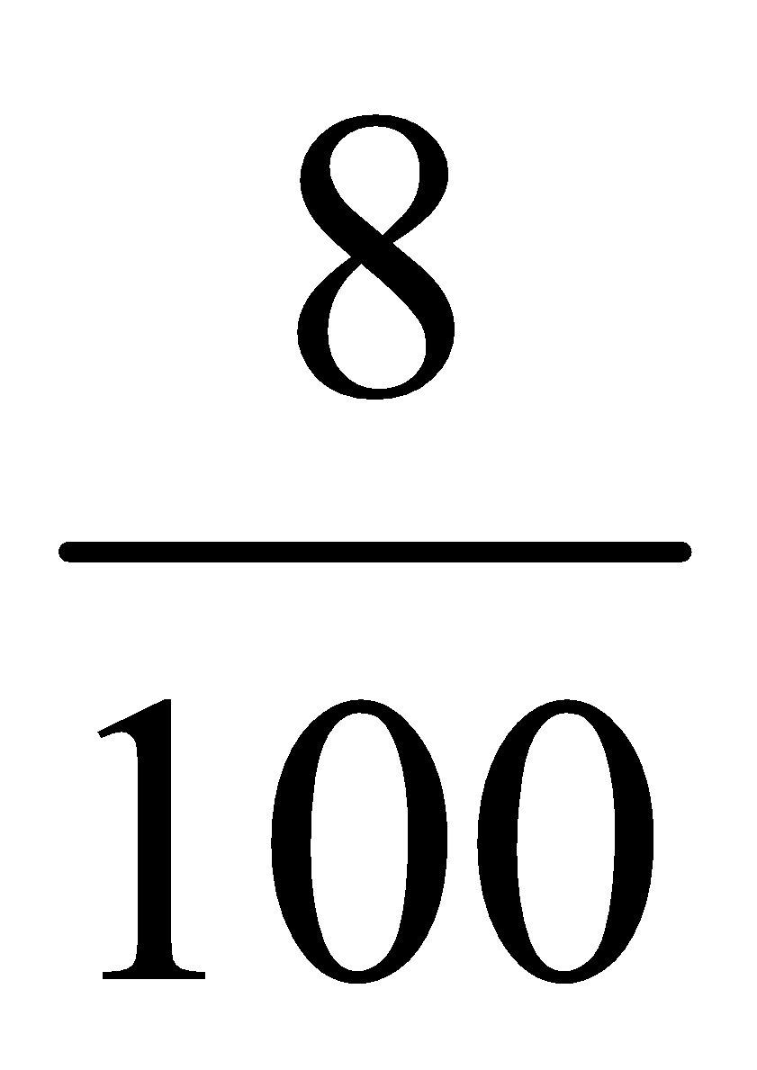
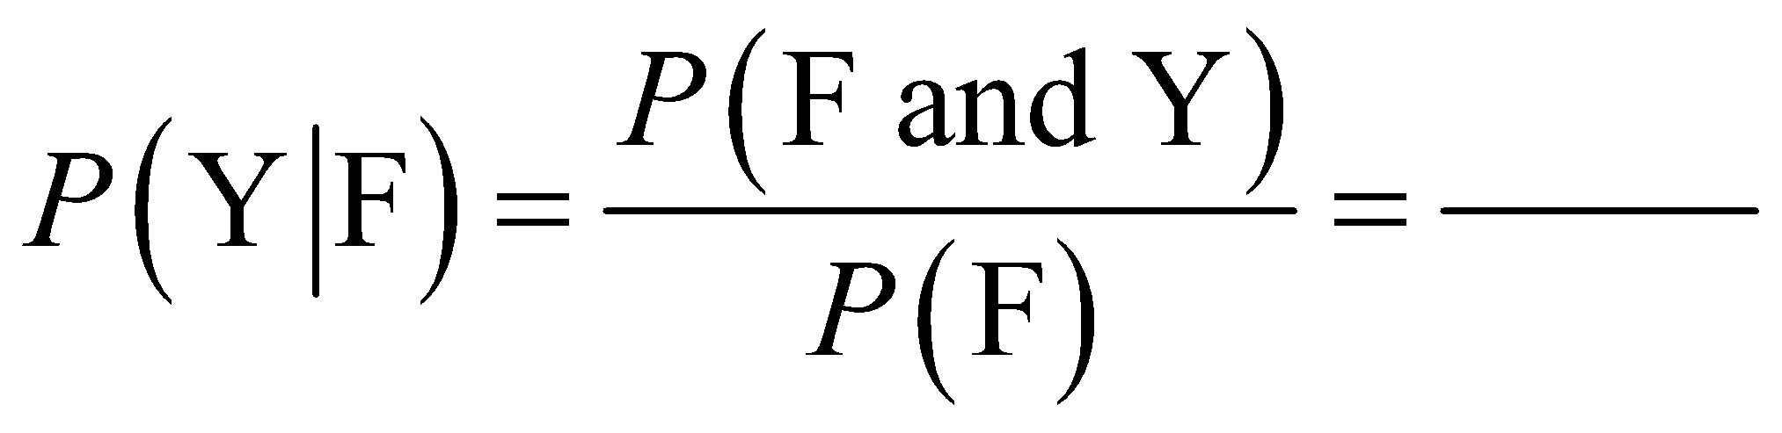
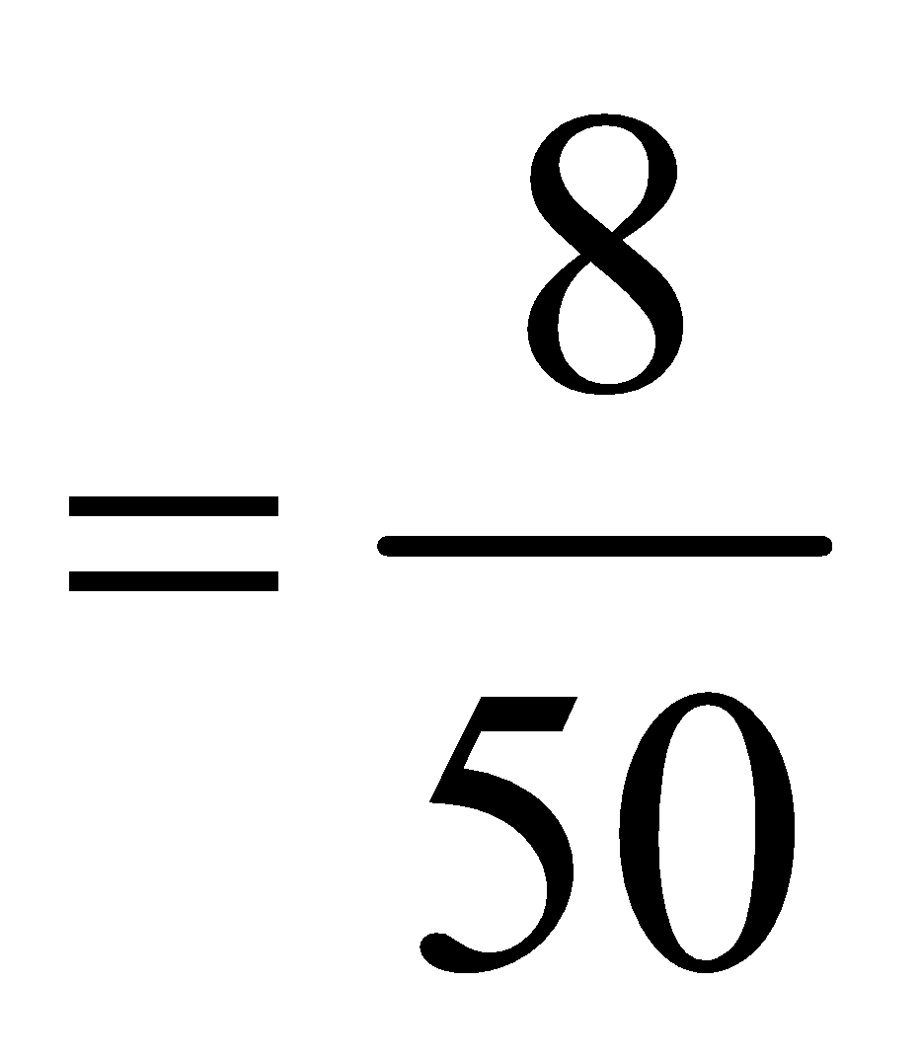
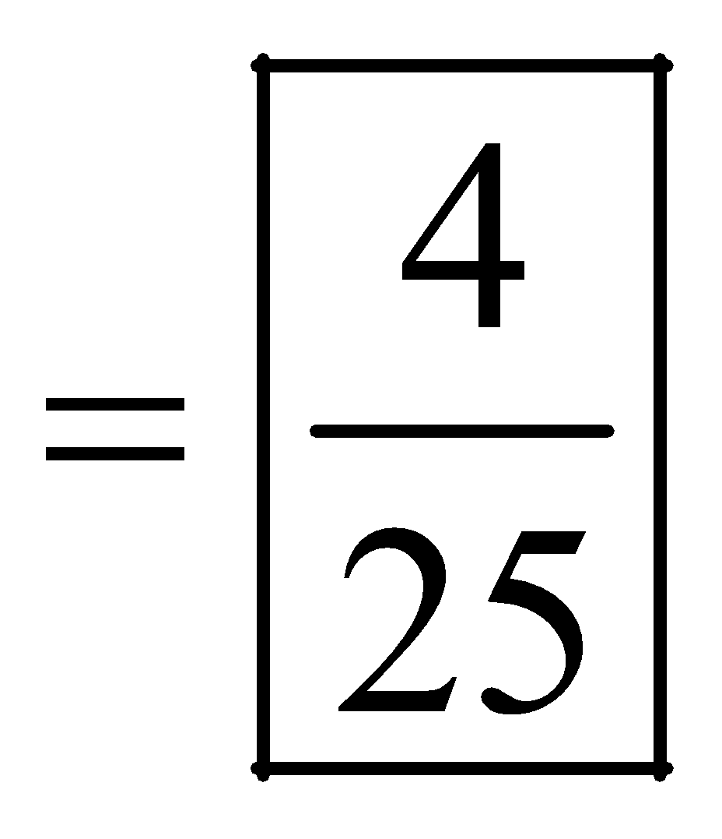
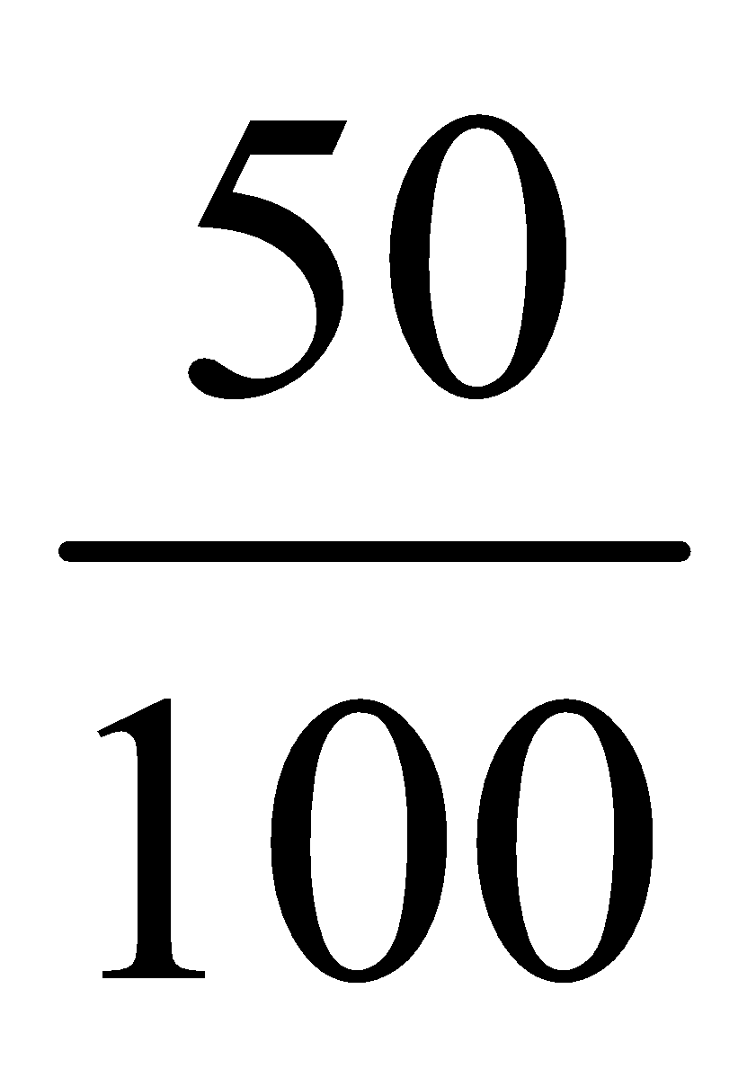
Women in the Military
a. Find the probability that the respondent answered yes (Y), given that the respondent was a female (F).

Slide 90
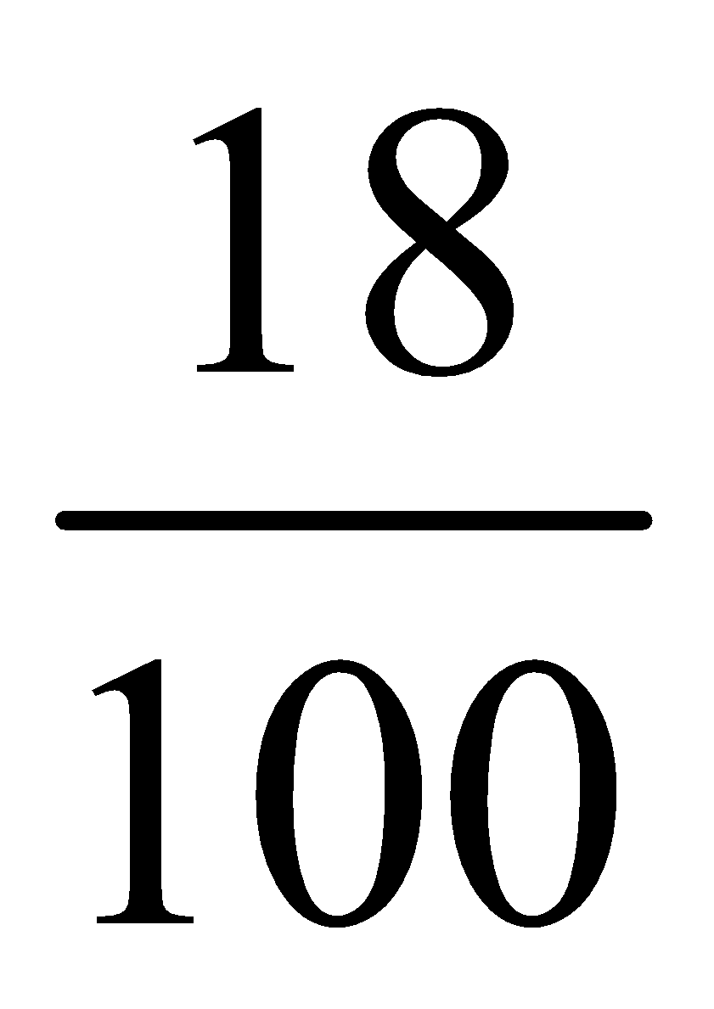
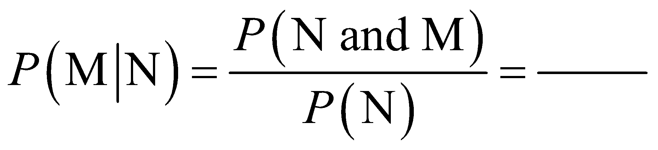
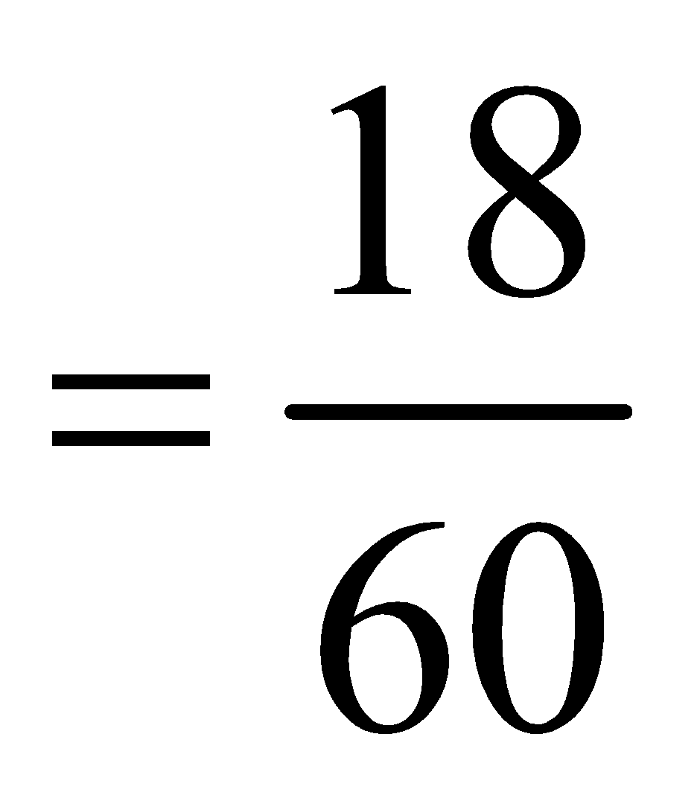
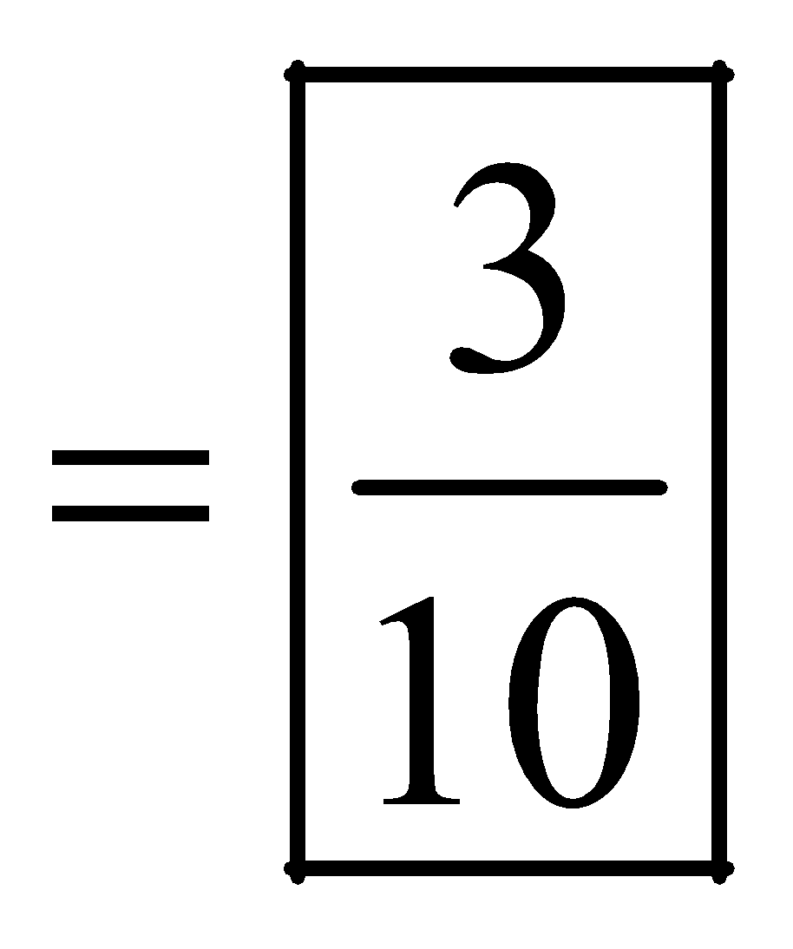
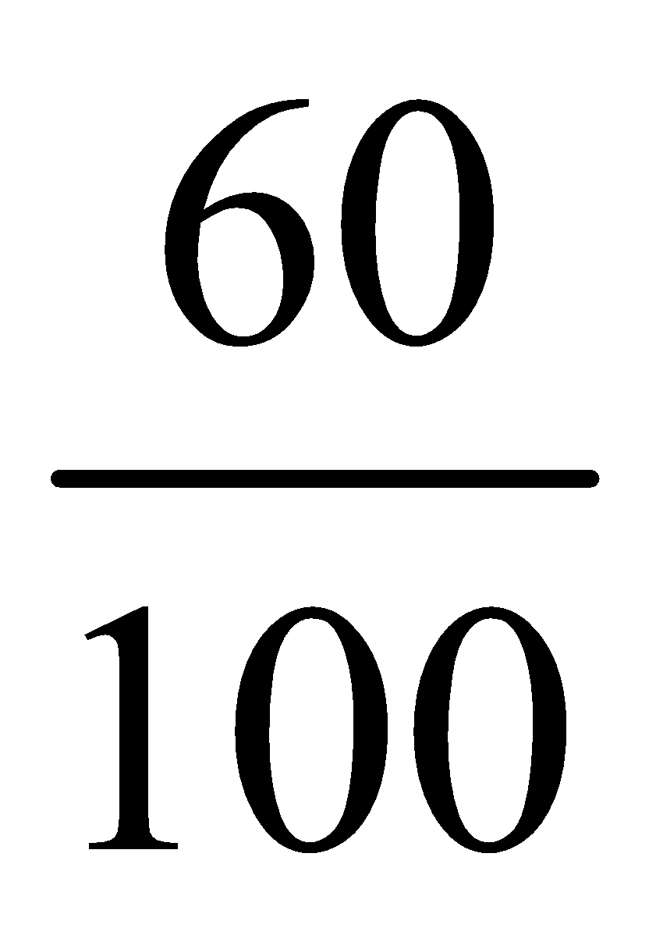
Women in the Military
b. Find the probability that the respondent was a male (M), given that the respondent answered no (N).

Slide 91
Probability Distributions
A random variable is a variable whose values are determined by chance.
A probability distribution consists of the values a random variable can assume and the corresponding probabilities of the values.
The sum of the probabilities of all events in a sample space add up to 1. Each probability is between 0 and 1, inclusively.

Slide 92
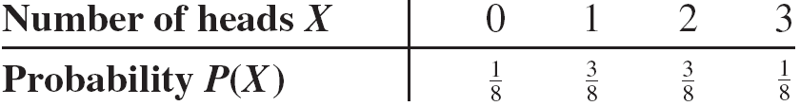
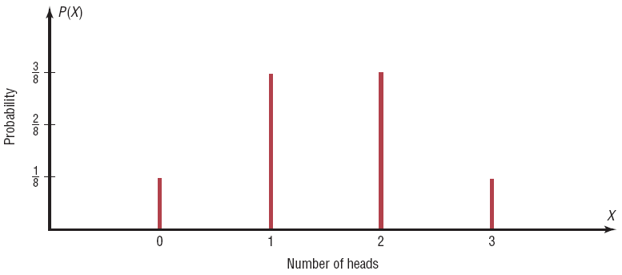
Example: Tossing Coins
Represent graphically the probability distribution for the sample space for tossing three coins.
.

Slide 93
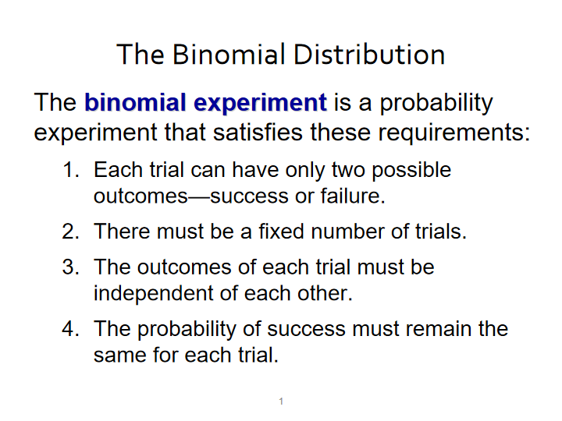

Slide 94
The Binomial Distribution
The mean, variance, and standard deviation of a variable that has the binomial distribution can be found using the below formulae

Slide 95
Rolling a die
A die is rolled 480 times . Find the mean, variance and standard deviation of the number of 2s that will be rolled. What is the expected value of the number of 2s?

Slide 96
The Poisson Distribution
The Poisson distribution is a distribution useful when n is large and p is small and when the independent variables occur over a period of time.
The Poisson distribution can also be used when a density of items is distributed over a given area or volume, such as the number of plants growing per acre or the number of defects in a given length of videotape.

Slide 97
The Poisson Distribution
Poisson Distribution
The probability of X occurrences in an interval of time, volume, area, etc., for a variable, where λ (Greek letter lambda) is the mean number of occurrences per unit (time, volume, area, etc.), is
The letter e is a constant approximately equal to 2.7183.

Slide 98
Normal Distributions
Many continuous variables have distributions that are bell-shaped known as approximately normally distributed variables.
The theoretical curve, called the bell curve or the Gaussian distribution, can be used to study many variables that aare approximately normal.
A normal distribution is a continuous , symmetric, bell shaped distribution of a variable

Slide 99
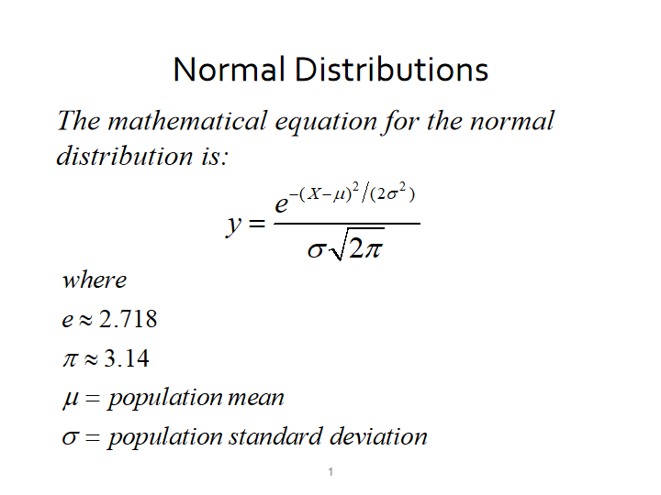

Slide 100
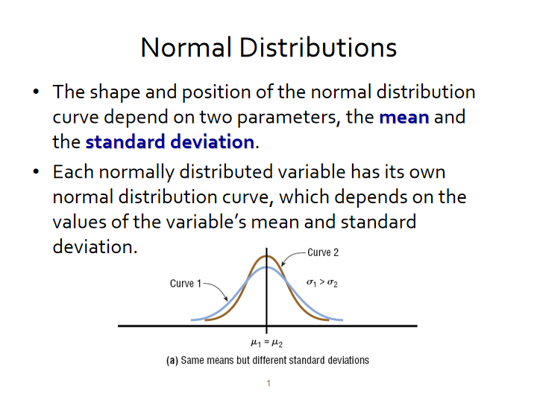

Slide 101
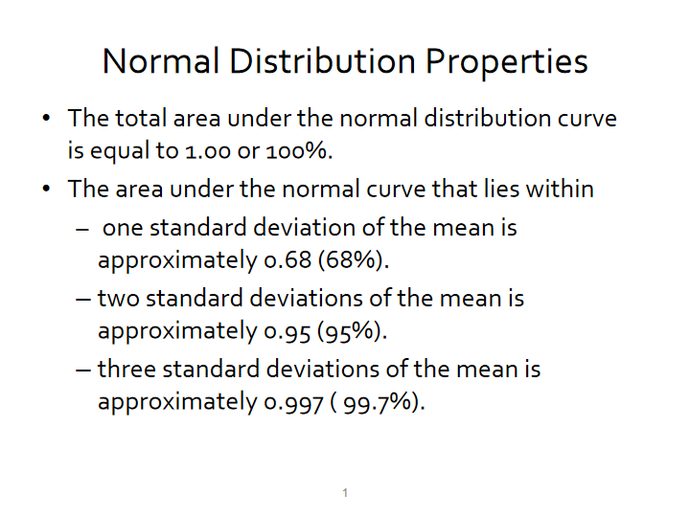

Slide 102
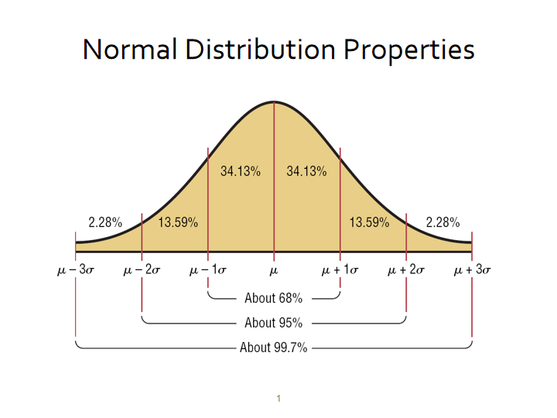

Slide 103
Standard Normal Distribution
Since each normally distributed variable has its own mean and standard deviation, the shape and location of these curves will vary. In practical applications, one would have to have a table of areas under the curve for each variable. To simplify this, statisticians use the standard normal distribution.
The standard normal distribution is a normal distribution with a mean of 0 and a standard deviation of 1.

Slide 104
z value (Standard Value)
The z value is the number of standard deviations that a particular X value is away from the mean. The formula for finding the z value is:

Slide 105
A Normal Distribution as a Probability Distribution
A normal distribution curve can be used as a probability distribution curve for normally distributed variables
The area under the standard normal curve can also be though of as a probability

Slide 106
Applications of the Normal Distributions
The standard normal distribution curve can be used to solve a wide variety of practical problems. The only requirement is that the variable be normally or approximately normally distributed.
For all the problems presented in this chapter, you can assume that the variable is normally or approximately normally distributed.

Slide 107
STEP 4- Inference

Slide 108
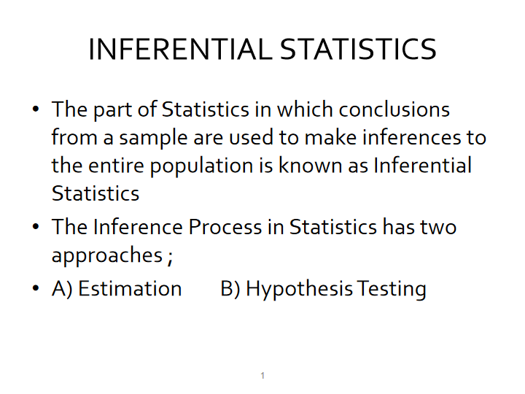

Slide 109


Slide 110


Slide 111
Confidence Interval Formula
For a 90% confidence interval:
For a 95% confidence interval:
For a 99% confidence interval:

Slide 112


Slide 113
HYPOTHESIS TESTING FLOWCHART
HYPOYHESIS TEST
Decision: REJECT NULL HYPOTHESIS
Conclusion: There is enough evidence to support the claim
Decision:
NOT REJECT NULL HYPOTHESIS
Conclusion: Thereis not enough evidence to support the claim

Slide 114

Hypothesis Testing

Slide 115


Slide 116


Slide 117
TESTS of SIGNIFICANCE aka Statistical Tests
Single sample z- test
Single sample t-test
Independent Samples t-test
DependenSt Samples t-test
Chi-square Test
ANOVA
Test of Correlation

Slide 118
Intro to ML

Slide 119

What are AI, ML and DS?
Notes:
AI- artificial Intelligence is a huge set of tools for making computers behave intelligently
ML- Machine Learning is the most prevalent subset of AI followed by Robotics
DS- Data Science deals with discovery and creating insights from data. ML is often an important data science tool.
DL- Deep Learning ,aka neural networks is a special area of ML and is best when inputs are images or text

Slide 120
What is ML ?
It is software/program that can learn from experience(data)
ML gives computers the ability to learn from data without being explicitly programmed (`Arthur Samuel’ , 1959)

Slide 121
Traditional programming vs ML
The Output of ML is the Model

Slide 122

How does ML model look like in practice ?
Model -→ A statistical representation of a real world process based on data
X→ Training data also called features
y→ prediction also called labels
f(x)→ML algorithm for Training into a Model

Slide 123
What is ML?
We define ML as a set of tools for making inferences and prediction from data
Often inferences and prediction work together, inferences help make prediction
ML is interdisciplinary mix of statistics and computer science
Learn pattern from existing data and apply to new data , e.g learn to detect spam from historical data and use that knowledge to identify spam in new data

Slide 124
Fundamental difference between stats & ML
Machine learning tends to deal with large complex datasets such as dataset of millions of images each containing 1000s of pixels
Classical statistical analysis such as Bayesian analysis would be impractical for such datasets

Slide 125

Pop quiz
State True or False
A) To make predictions from ML model you need data
B) ML finds patterns in existing data & apply to new data
C) ML can only predict what will happen and not explain why something happens
D) ML’s applications is not limited to one type of problem/domain
TRUE
FALSE

Slide 126

THE ML DIAGRAM
Notes:
Regression- when goal is to predict a numerical variable like House Price
Classification- when goal is to predict a class like Fraud/Not Fraud

Slide 127
ML concepts
Supervised Learning
→Training data has both features and label
→ features=predictor variables=IVs
→ target variable=response variable=DV
→given a set of features/label pairs find a mapping that predicts the label associated with previously unseen input .
Unsupervised Learning – Training data has only features i.e we don’t know the right answers
→eg. Anomaly detection
→Clustering – dividing data into groups based on similarity
→given a set of feature vectors( without labels) group them ‘natural clusters( labels for the groups)

Slide 128
Goal of Supervised Learning
Automate time consuming or expensive manual task , eg. Doctor’s diagnosis
Make predictions about the future→ will a customer click on the ad or not
Need labelled data
→ get historical data with labels
→experiment to get labelled data ( eg. A/B testing to check no. of ad clicks)
→crowd sourcing labelled data , eg. Recaptcha does for text recognition
GOAL: HAVE DATA WITH RIGHT PREDICTION LABELS SO THAT WE CAN TRAIN A MODEL TO PREDICT ACCURATELY FOR NEW DATA

Slide 129
Supervised Learning in python
We will use scikit learn/sklearn ( an industry standard package )
→ integrates well with SciPy package
Other libraries
→ tensorflow
→ Keras

Slide 130

Pop quiz
Which is a classification problem
Using labeled financial data to predict whether the value of a stock will go up or go down next week.
Using labeled housing price data to predict the price of a new house based on various features.
Using unlabeled data to cluster the students of an online education company into different categories based on their learning styles
Using labeled financial data to predict what the value of a stock will be next week.

Slide 131
Data Scientist Toolkit
CLASSIFICATION
Logistic Regression.
k-Nearest Neighbors.
Decision Trees.
Random Forests
Support Vector Machine
Naive Bayes.
Gradient Boosting Trees
AdaBoost
XGBoost
REGRESSION
Linear regression
Lasso Regression
Ridge Regression
Decision Tree Regressor
Support Vector Regression
Random Forest Regressor.
Clustering
K-means
Hierarchical clustering
DBScan

Slide 132
Model evaluation
To compute model evaluat metrics we should use data the model has not seen before.
Split the dataset into training and testing data .
Fit/train the classifier on the training set .
Make the predictions on test set .
Compare predictions with known labels

Slide 133

Model evaluation
For Classification
For Regression
Accuracy – In classification accuracy is a commonly used metric. Accuracy is the fraction of correct predictions
Precision- It is the model’s probability to convert. How accurate are the model’s predictions
Recall- model’s ability to recall the genuine positive values. It’s a measure of the models reach, ie higher the recall higher the reach
Coefficient of determination(R2)- a statistical measure of how well the data fits the regression line
Mean square error (MSE) – It is a measure of the mean of the squared error

Slide 134

The Confusion Matrix

Slide 135

Adapted from Deep Learning.AI
Notes:
1. Scoping- define the Project what you have to work on, what is X and what is Y
2. Collect the Data -- Define the data , labelling and organizing data
3. Model Training - Select and Train the model and evaluate the model(error analysis) --> update the model or collect mode data
-- > We also do Model optimization to ensure that the ML model is reliable and ready for Production --> Model interpretation to explain the
model
4. Deploy the model to production turn on the traffic --> track the data coming and monitor the system, eg if data distribution changes( data drift)we need to update the system--> by doing model evaluation --> take the new data and retrain the model and put it in production ( we need to monitor and maintain the system periodically)

Slide 136
Supervised Learning Steps-DEMO
1. Data Acquisition
- Data sanity checks
- Data Cleaning- transform the data types, remove unneccesary characters
2. Exploratory Data Analysis – univariate & bivariates & correlations
3. Data Preprocessing
- Check for nulls and impute if needed
- separate features and label
- Do the label encoding
- Solve data imbalance issue (if needed)
- Do a train test split
-scale the features (if needed, though it’s a good practice to scale the features)
4. Model Building with training data – Fit the model
5. Model evaluation with test data – Check the metrics
6. Model optimization-Hyperparameter tuning
7. Model interpretation
8. Deployment

Slide 137
Resources
Machine Learning Book ---https://www.ime.unicamp.br/~dias/Intoduction%20to%20Statistical%20Learning.pdf
Machine Learning Book Advanced- https://web.stanford.edu/~hastie/Papers/ESLII.pdf
DeepLearning.AI --https://www.deeplearning.ai
For SMOTE---https://machinelearningmastery.com/smote-oversampling-for-imbalanced-classification/

Slide 138
THANK YOU !

